Slide 1
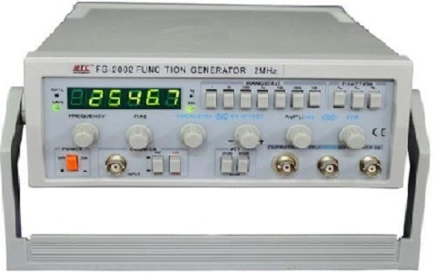
signal generator
By-HARSHITHA MASUR
(AE-016)

Slide 2
SIGNAL GENERATOR
A signal generator is an electronic test instrument that creates or generates either repeating or non-repeating waveforms.
These waveform can be of different shapes and amplitude.

Slide 3
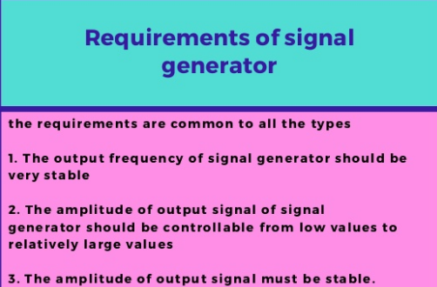

Slide 4

Purpose of signal generator

Slide 5
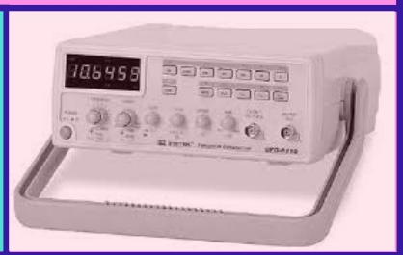
uses
Signal generators of all types are mostly used in designing, manufacturing, servicing and repairing electronic devices.

Slide 6
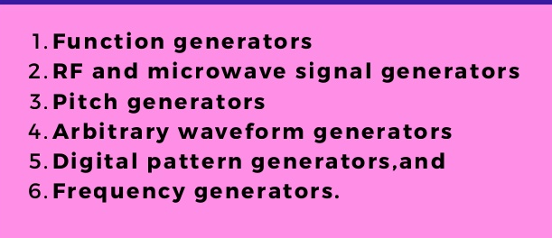
types

Slide 7
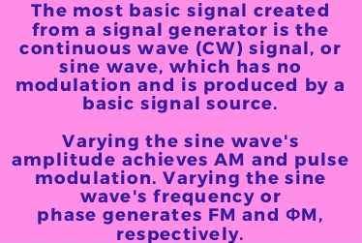
How a signal generated?

Slide 8
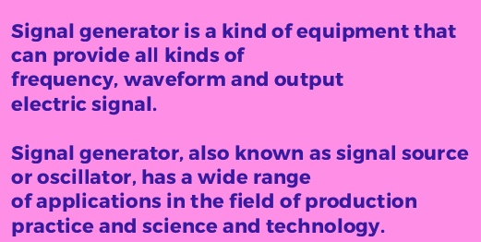
applications

Slide 9


